Slide 1
OPG
Supervisor : Professor Dr Azian Bt Abd Aziz
Presenter : Mohamad Razlin Hamdani Bin Mohd Rafi

Slide 2
ORTHOPANTOMOGRAM
*An OPG is a panoramic or wide view x-ray(dental radiography) of the lower facial structure, which displays all the teeth of the upper and lower jaw including the lower maxillary sinus and the arches of mandibular and their support structure on a single film.

Slide 3
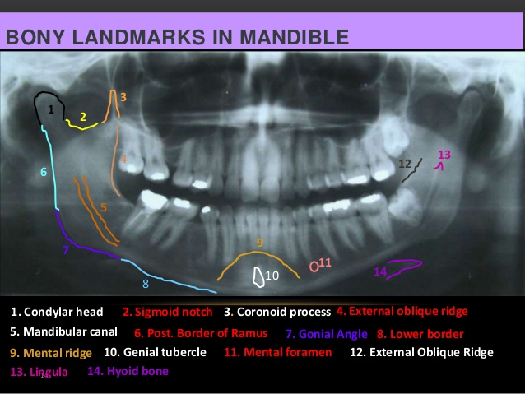
ANATOMY
Notes:
TEMPORAL BONES: the side and base of the skull. Each consists 5 parts : squama, petrous, mastoid & styloid process
EAC (EXTERNAL AUDITORY CANAL)

Slide 4
INDICATIONS
Impacted teeth
Third molar
Abnormality in OPG structure (supernumery teeth, wormian bone, polydontia, cyst and etc)
MVA (involving OPG structure)
Post op procedure

Slide 5
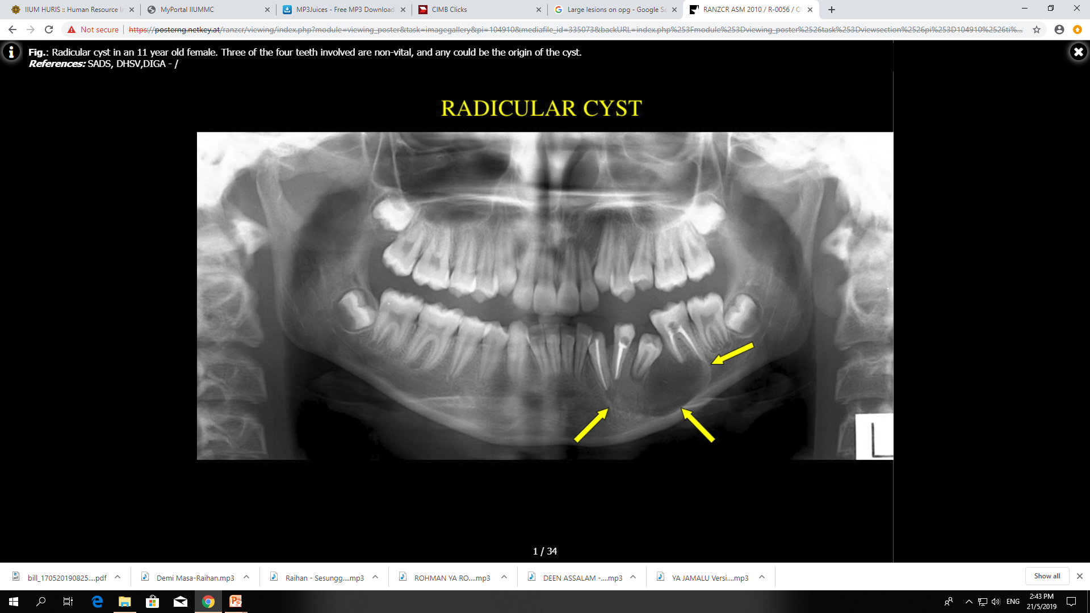
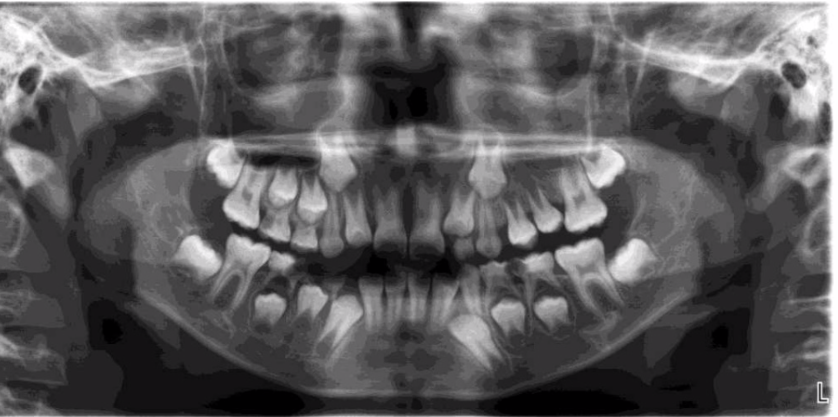
EXAMPLE OF INDICATIONS
CYST
SUPERNUMERY TEETH

Slide 6
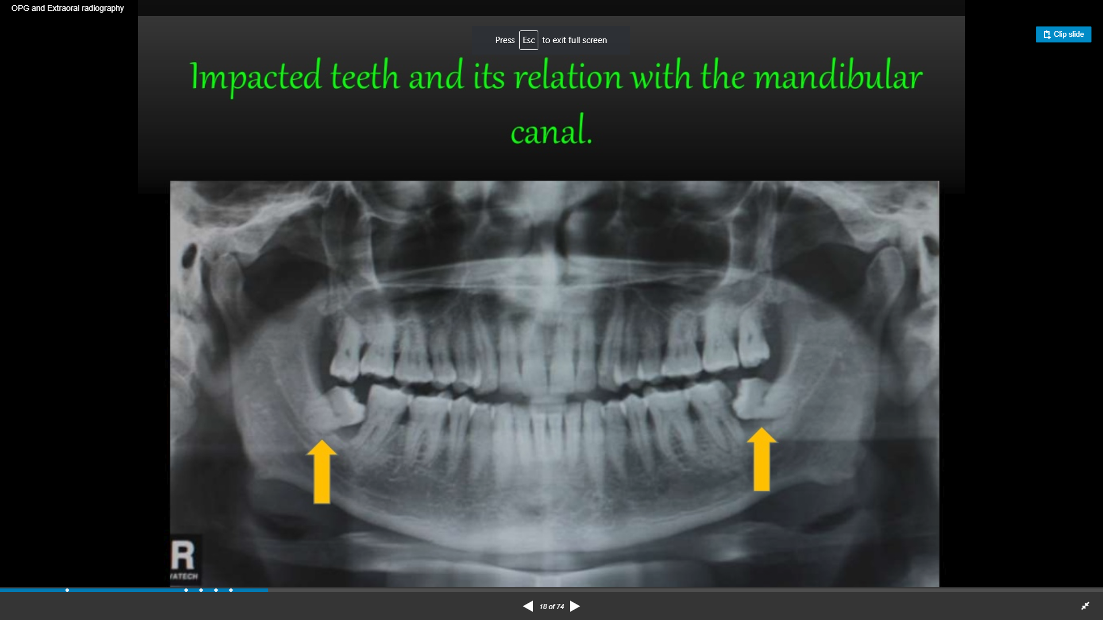
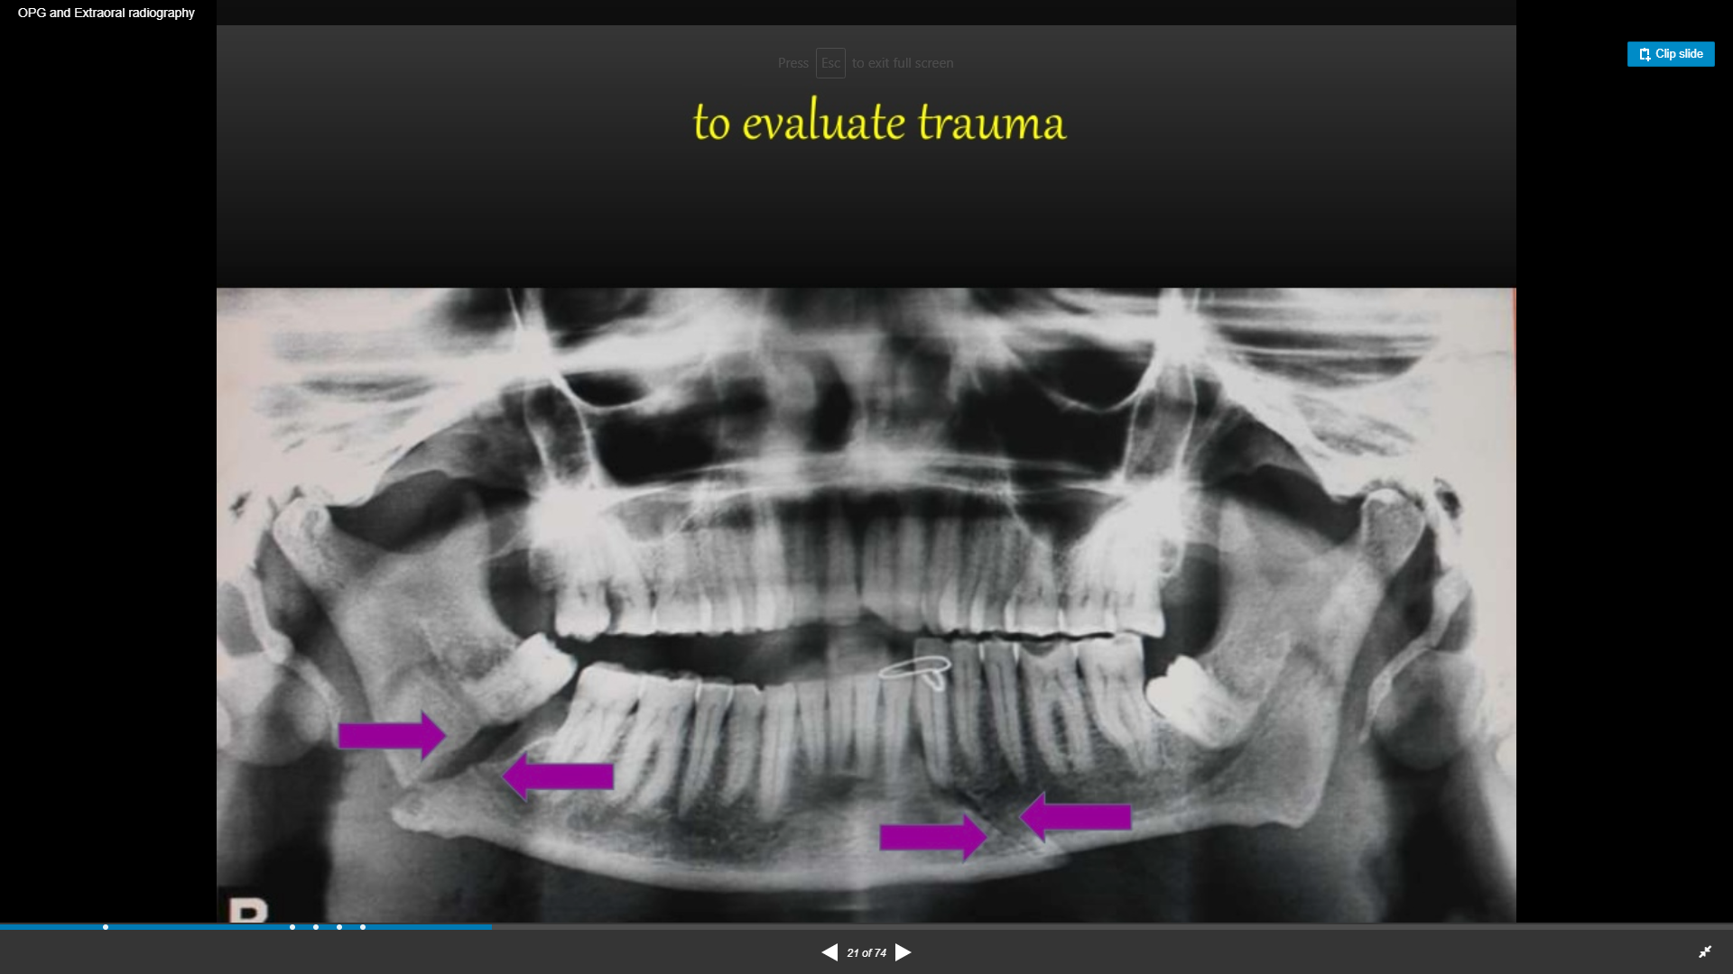
IMPACTED TEETH
MVA

Slide 7
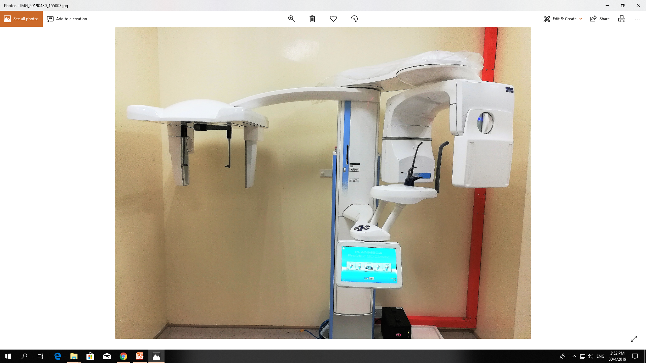
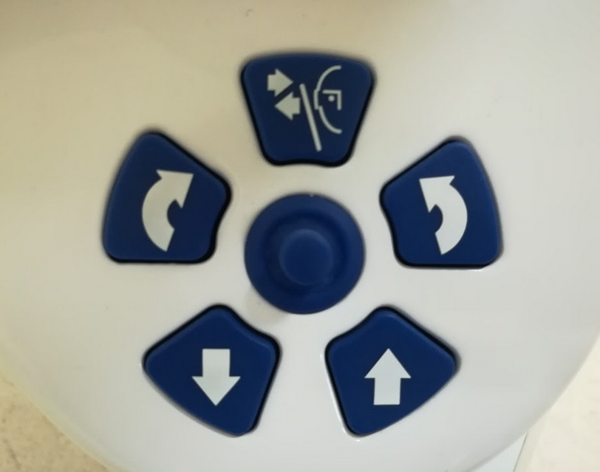
X-ray unit : Planmeca Promax
LIST OF PROCEDURES DONE IN RADIOLOGY DEPARTMENT:
-OPG
-CBCT(CONE BEAM COMPUTED TOMOGRAPHY)
-LATERAL CEPHALOGRAM

Slide 8
PATIENT PREPARATION
REMOVED:
JEWELLERIES
DENTURES
HAIR CLIP
HEARING AIDS
BROOCH
SPECTACLES
*LMP FOR FEMALE
*WEAR LEAD APRON IS A MUST!

Slide 9
PATIENT POSITIONING
Patient stand straight, adjust OPG unit height by adjusting buttons according to patients height related to patient’s chin on chin rest.
Grasp patient handles (cross hand) , step slightly forward, bite on BOTH grooves of the bite piece and place tongue to hard palate.
Laser beam light as indicator. Adjust layer light between patients lateral incisor and canine.
Patient head must straight to midsagittal plane light.
Select jaw shape and size accordingly.
Close temple support to ensure no movement during exposure.
Press exposure button at control console when it ready for exposure.

Slide 10
INSTRUCTIONS
Patient should DO :
No swallowing.
Place tongue on hard palate.
Close lips during exposure.
Ensure no head movement while imaged being captured.

Slide 11
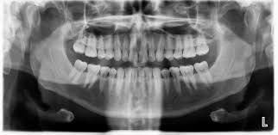
EXAMPLE OF OPG IMAGE

Slide 12
Thank You.

